Slide 1
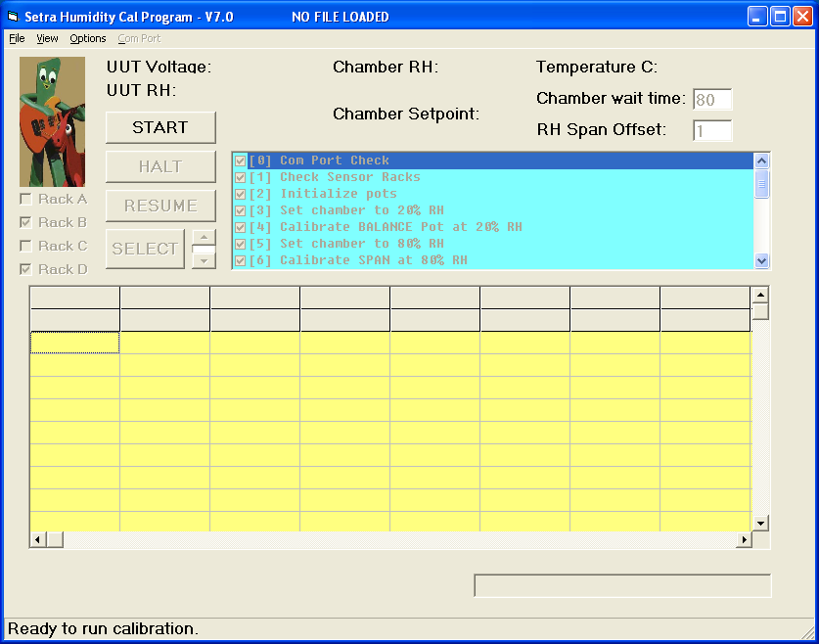
Setra Humidity Cal System:
ready to calibrate 128!

Slide 2
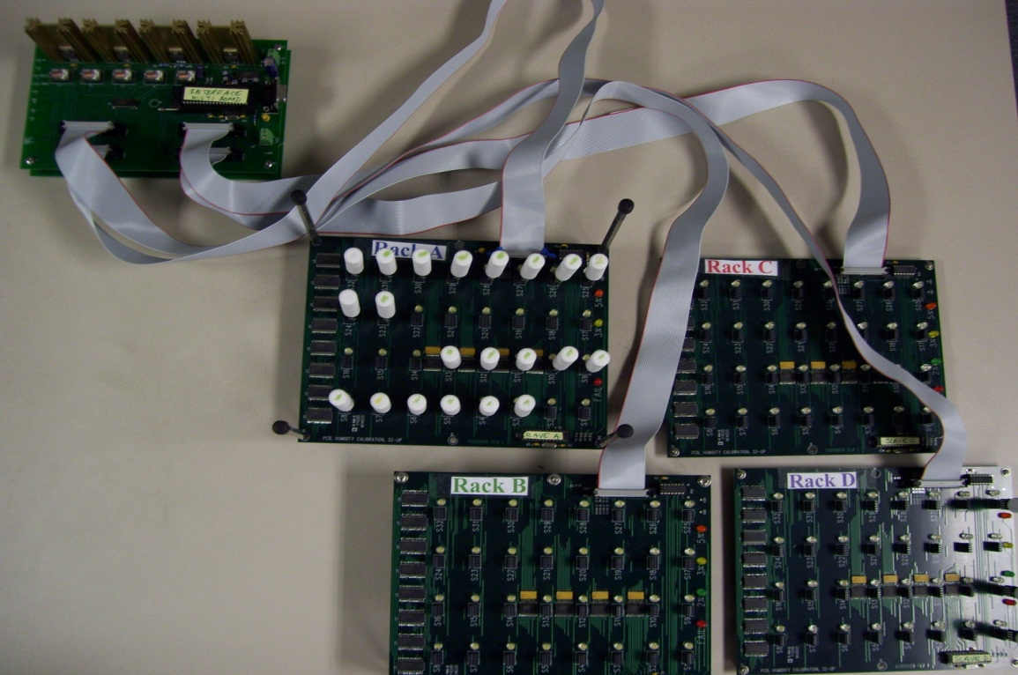
Multiple Rack Cal System
Four racks hold 32 sensor tips each
LEDS indicate each pass/fail category: 2%, 3%, 5%, and FAIL
Multiple runs possible in a single day – each gets a unique filename.
Fully functioning calibration on both Thunder and Humilab.

Slide 3
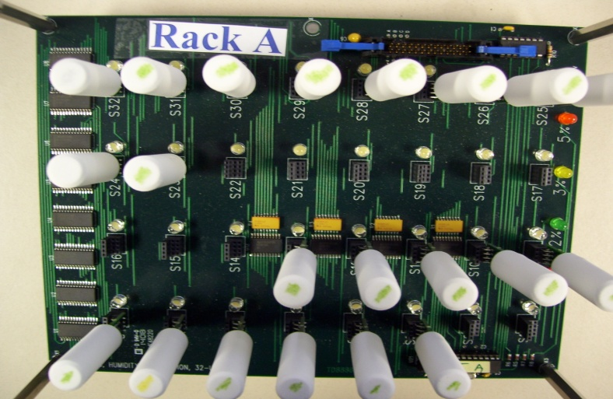
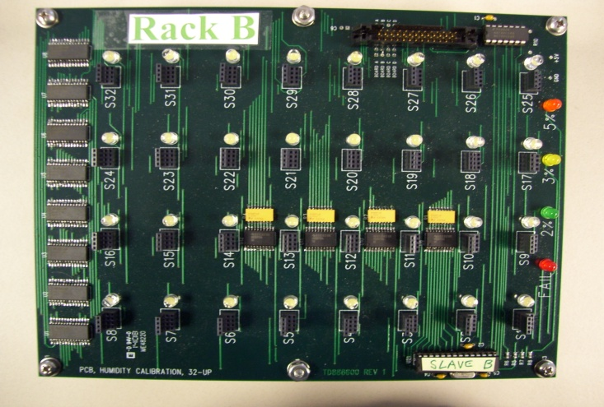
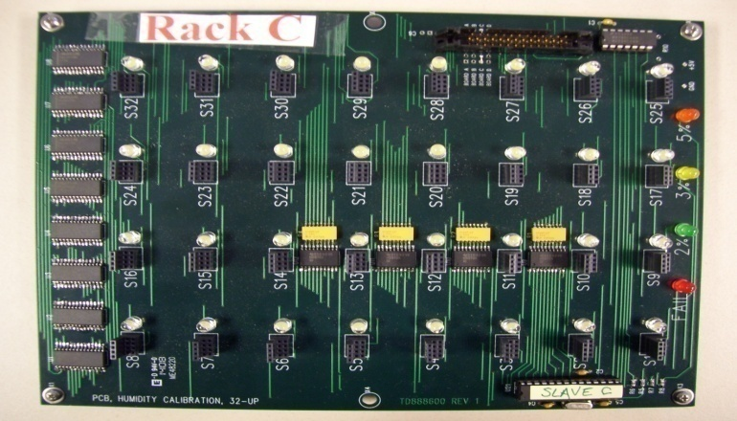
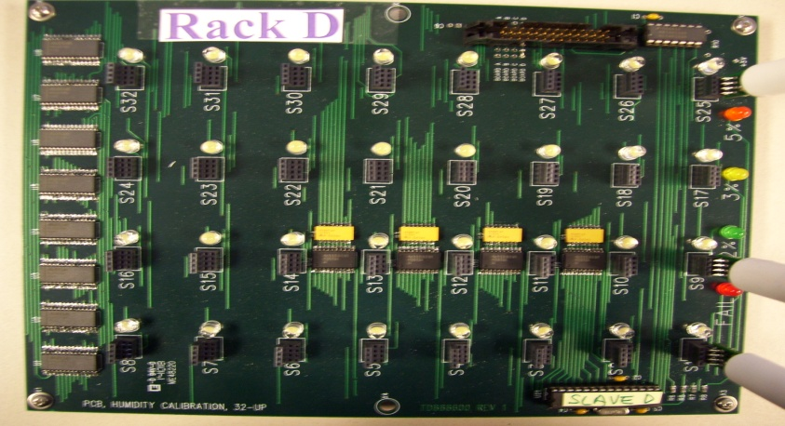
Spreadsheet clearly matches data to racks and sockets
>A #S1
>A #S2, ETC
>A #S32
>B #S1
>B #S2, ETC
>B #S32
>C #S1
>C #S2, ETC
>C #S32
>D #S1
>D #S2, ETC
>D #S32

Slide 4

Any combination of racks may be used.
No empty blocks on spreadsheet.
>B #S1
>B #S2, ETC
>B #S32
>D #S1
>D #S2, ETC
>D #S32
Racks are “smart”, so they automatically ID themselves when polled by host PC.

Slide 5
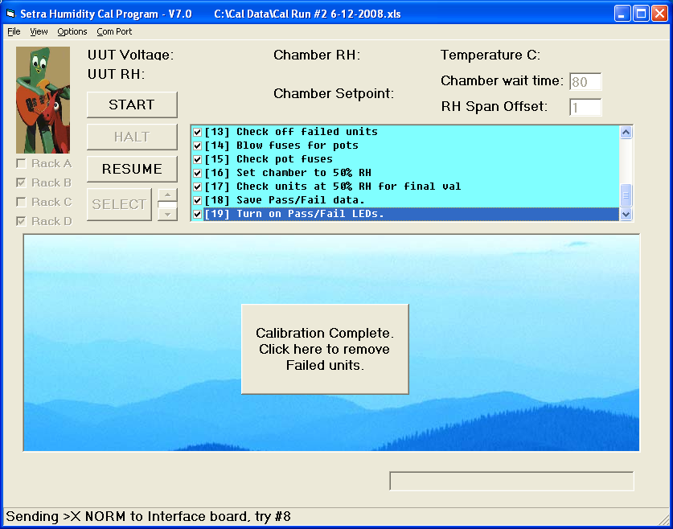
LEDS on all four racks can be activated any time once calibration is done.
Blue sky gets attention.
We’re all done!
File can be reloaded to activate LEDs
if user inadvertently shuts program down.

Slide 6
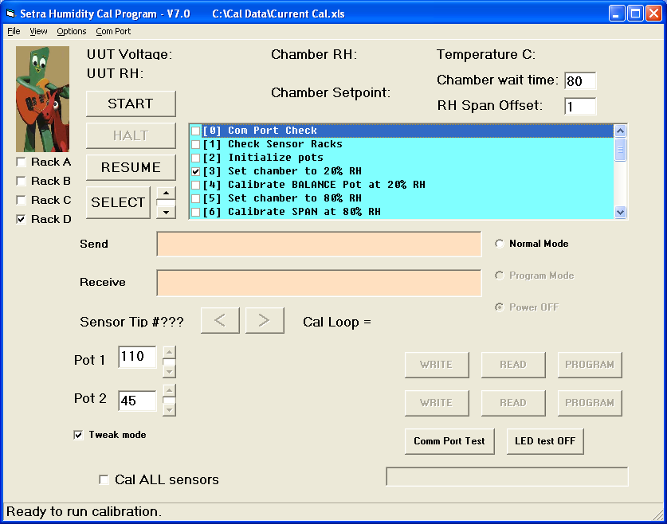
Diagnostics are password protected for special tests and troubleshooting.
Any sensor can be individually examined any time
While calibration is in progress, sensors can be troubleshot and tweaked.
Calibration process can be studied up close.
Communication with sensor tips may be monitored.
Process can be customized
Racks can be enabled
Individual pots may be set to any value

Slide 7
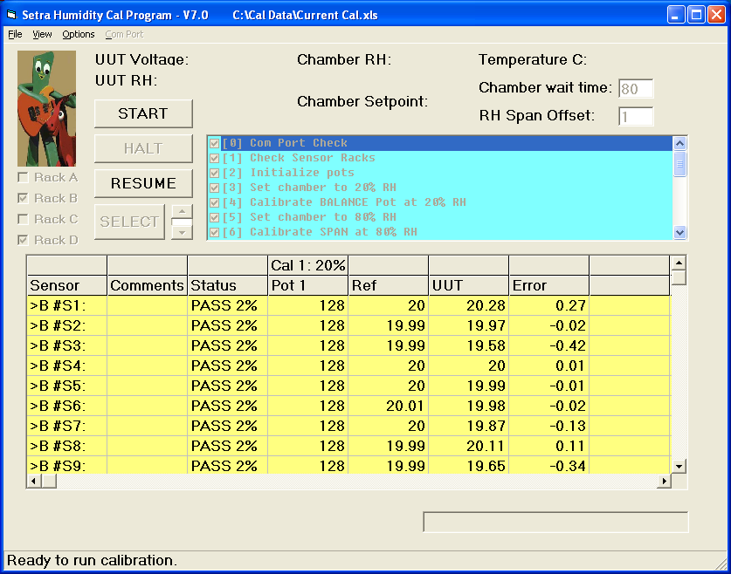
Run mode features diagnostics to alert technician about problems.
Latest readings displayed
from sensor tips and chamber.
Indicators assure technician
that racks are plugged in
Data grid duplicates spreadsheet.

Slide 8
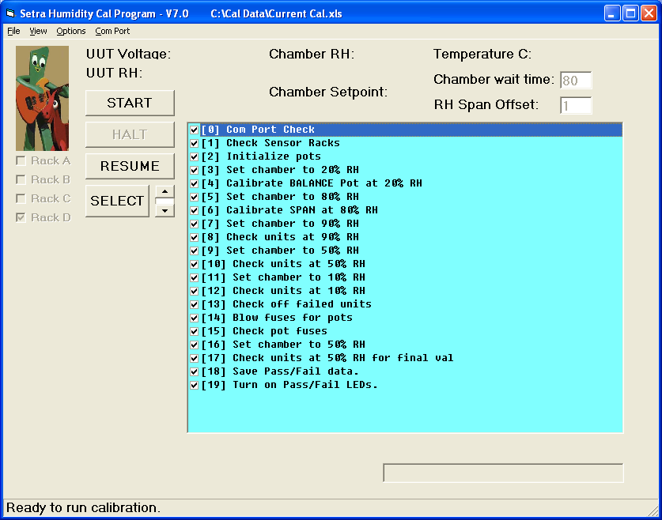
Task box displays entire process at a glance.

Slide 9
Twenty step process is thorough and flexible.
‘SYSTEM CHECK:
‘[0] Com Port Check" - checks communication with Interface board, Fluke, and Thunder
‘[1] Check Sensor Racks" – polls the four racks A, B, C, and D to see which are present
‘[2] Initialize pots" – polls each socket to see which have sensors in them.
‘BALANCE AND SPAN POT CALIBRATION:
‘[3] Set chamber to 20% RH"
‘[4] Calibrate BALANCE Pot at 20% RH"
‘[5] Set chamber to 80% RH"
‘[6] Calibrate SPAN at 80% RH“
‘CHECK RH ACCURACY AT THREE VALIDATION POINTS:
‘[7] Set chamber to 90% RH"
‘[8] Check units at 90% RH"
‘[9] Set chamber to 50% RH"
‘[10] Check units at 50% RH"
‘[11] Set chamber to 10% RH"
‘[12] Check units at 10% RH“
‘ BLOW FUSES ON GOOD UNITS AND CHECK FUSES:
‘[13] Check off failed units" – If unit is failing so far, do not blow fuse.
‘[14] Blow fuses for pots" - Blow fuses for both balance and span pots.
‘[15] Check pot fuses" - Cycle power off and on, then check pots and fuses.
‘CHECK RH AT 50%, SAVE DATA, TURN ON PASS/FAIL LEDS, SHUT DOWN:
‘[16] Set chamber to 50% RH" – Do one final RH validation at 50%
‘[17] Check units at 50% RH for final val"
‘[18] Save Pass/Fail data." – Check all cal and validation points for 2%, 3%, 5% units.
‘[19] Turn on Pass/Fail LEDs." – Turn on LEDS to indicate passing and failing units.

Slide 10
Sensor Tip Calibration
DOES SENSOR COMMUNICATE ?
NO
YES
SOCKET = “NONE”
DO NOT CALIBRATE
WAS SENSOR CALIBRATED ?
YES
NO
READ POTS, RECORD IN SPREADSHEET
INITIALIZE POTS TO 128
CALIBRATE BALANCE AT 20% RH
CALIBRATE SPAN AT 80% RH
RECORD POT VALUES AND TAKE DATA AT BALANCE, SPAN.
TAKE DATA AT 90%, %50, 10%

Slide 11
Programming and Final Verification
IS SENSOR PASSING AT %10,20,50,80,90?
NO
YES
SENSOR FAILS
DO NOT PROGRAM
BLOW FUSES, CYCLE POWER
DO POTS MATCH SPREADSHEET VALUES?
NO
YES
SENSOR FAILS
TAKE DATA AT %50
RECORD DATA IN SPREADSHEET WITH DATE AND RUN #
INIDCATE 2%, 3%, 5% BATCHES WITH LEDS

Slide 12
Ongoing System Self Checks
ARE THE THUNDER, FLUKE, AND INTERFACE BOARD COMMUNICATING?
NO
RETRY SEVERAL TIMES, THEN HALT.
ALERT USER WITH POP-UP BOX
YES
DOES THE THUNDER REACHTHE SETPOINTS?
NO
ALERT USER WITH POP-UP BOX KEEP TRYING
YES
DOES THE INTERFACE BOARD MULTIPLEX THE RIGHT SENSORS?
NO
RETRY SEVERAL TIMES, THEN HALT.
ALERT USER WITH POP-UP BOX
CONTINUE PROCESS

